Slide 1
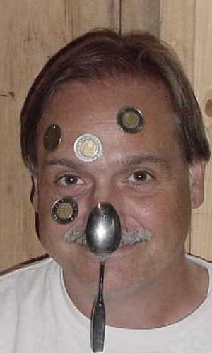
The Frilly Bits
O
A P T
John Caranci
OISE
Notes:
Coins on the face is a neat Bio/physics phenomena that many can do.

Slide 2
The Precepts of Classroom Demonstration
Voice quality 55 %
Body language 35 %
Content 7 %
Other 3 %
Notes:
Many psychology and businesses use this as basic presentation methods. Ask any stage actor and you will get the same message. Voice quality draws people in and shows how exciting th demo is. These are called kinesics, para-language and haptics.

Slide 3
Intrinsically Interesting Objects
Tops
Bubbles,
Elastic bands
Plasticine
Balloons
Ball bearings, Etc.
Notes:
These can be the basics for many demos. Place any of these on a table and they will be played with. This is not a function of age.

Slide 4
Look for/to
Enhance drama and suspense
The aha or the ahh
Intrinsically interesting ideas, events, phenomena, toys)
Discrepant events to confuse
Demos that wow
Cognitive dissonance
Science is magic; teachers magicians
Notes:
The basis is constructavism.

Slide 5
Learning How to Fly
Dramatic/Creative Synthesis
Stand on a Chair
Use Douglas Adam’s interpretation of orbit
Notes:
Taken from the master of funny science Douglas Adams in “The Hitchhikers Guide to the Galaxy”. DON’T PANIC! It is important to find the demos where you can.

Slide 6
"We are all apprentices of a craft where no one ever becomes a master." - Ernest Hemingway (1961)
Notes:
Hemingway was speaking of writing (or living?). But this is true of any craft. You can never win at the game of golf. So too, teaching. The craft of getting individuals/groups to learn. The craft is large in scope.

Slide 7
Moebius

Slide 8
Tri-Hexa-Flexa-Gon

Slide 9
Hexa-Hexa-Flexa-Gon

Slide 10
Tuning Forks and Bow

Slide 11
Singing Rods

Slide 12
Chladni Plates and Seeing Sound

Slide 13
Fields Demonstrator

Slide 14
Homopolar Electric Motor

Slide 15
Vacuum Hose

Slide 16
Gravity Tray

Slide 17
Spark Generator

Slide 18
Pascal’s Law Demonstrator

Slide 19
Tire Valve Bottle Rocket

Slide 20
Human Electric Power

Slide 21
Chain and Ring

Slide 22
Metal Hanger Chime

Slide 23
Mason Jar Accelerometer

Slide 24
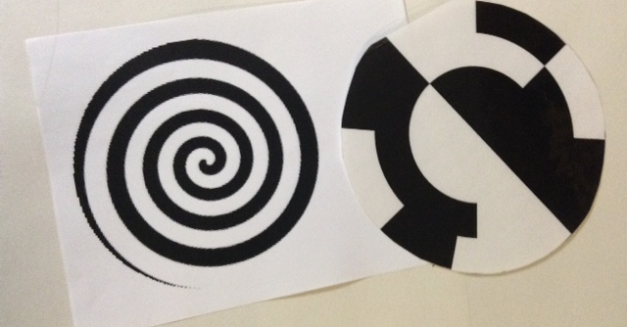
Light Retention Demonstrator

Slide 25
Inertia Demonstrator

Slide 26
Fibre Optic Demonstrator

Slide 27
Electric Wave Demonstrator

Slide 28
Wint-o-Green Lifesavers

Slide 29
Curve Ball Demonstrator

Slide 30
Bubbles

Slide 31
Black Light

Slide 32
Bed of Nails

Slide 33
CD Hovercraft

Slide 34
Accelerator

Slide 35
Australian Whizzer

Slide 36
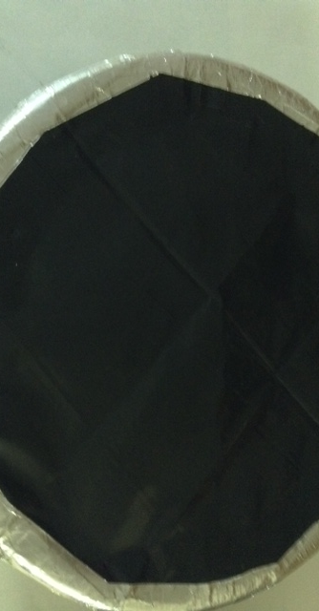
Air Cannon

Slide 37
Thanks to All

